Slide 1
Interaction styles

Slide 2

Common interaction styles
command line interface
menus
natural language
question/answer and query dialogue
form-fills and spreadsheets
WIMP
point and click
three–dimensional interfaces

Slide 3
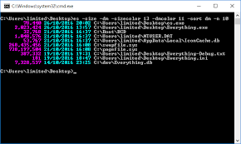
Command line interface
Way of expressing instructions to the computer directly
function keys, single characters, short abbreviations, whole words, or a combination
suitable for repetitive tasks
better for expert users than novices
offers direct access to system functionality
command names/abbreviations should be meaningful!
Typical example: the Unix system

Slide 4
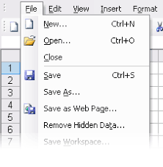
Menus
Set of options displayed on the screen
Options visible
less recall - easier to use
rely on recognition so names should be meaningful
Selection by:
numbers, letters, arrow keys, mouse
combination (e.g. mouse plus accelerators)
Often (frequent) options hierarchically grouped
sensible grouping is needed
Restricted form of full WIMP system

Slide 5
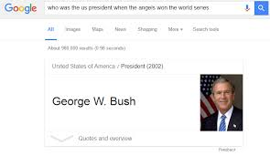
Natural language
Familiar to user
speech recognition or typed natural language
Problems
vague
ambiguous
hard to do well!
Solutions
try to understand a subset
pick on key words

Slide 6
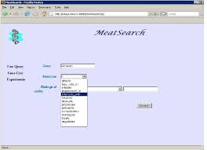
Query interfaces
Question/answer interfaces
user led through interaction via series of questions
suitable for novice users but restricted functionality
often used in information systems
Query languages (e.g. SQL)
used to retrieve information from database
requires understanding of database structure and language syntax, hence requires some expertise

Slide 7
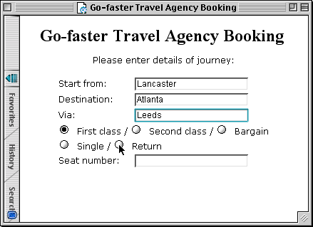
Form-fills
Primarily for data entry or data retrieval
Screen like paper form.
Data put in relevant place
Requires
good design
obvious correction facilities

Slide 8
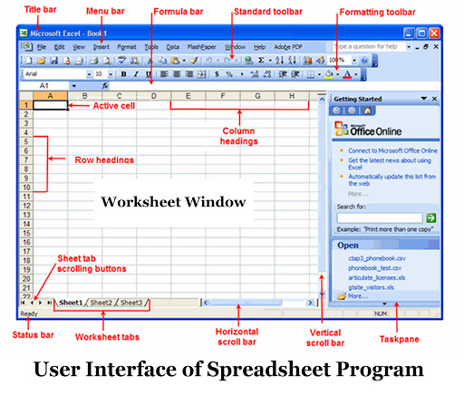
Spreadsheets
First spreadsheet VISICALC, followed by Lotus 1-2-3 MS Excel most common today
Sophisticated variation of form-filling.
grid of cells contain a value or a formula
formula can involve values of other cells e.g. sum of all cells in this column
user can enter and alter data spreadsheet maintains consistency

Slide 9
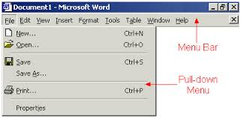
WIMP Interface
Windows
Icons
Menus
Pointers
… or windows, icons, mice, and pull-down menus!
default style for majority of interactive computer systems, especially PCs and desktop machines

Slide 10
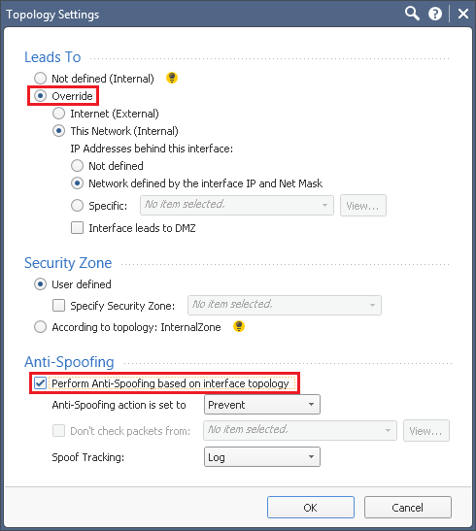
Point and click interfaces
used in ..
multimedia
web browsers
hypertext
just click something!
icons, text links or location on map
minimal typing

Slide 11
elements of the wimp interface
windows, icons, menus, pointers
+++
buttons, toolbars, palettes, dialog boxes
also see supplementary material on choosing wimp elements

Slide 12
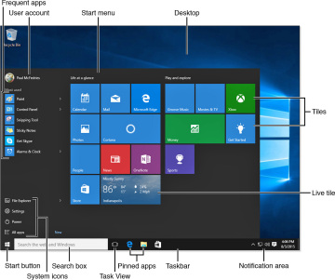
Windows
Areas of the screen that behave as if they were independent
can contain text or graphics
can be moved or resized
can overlap and obscure each other, or can be laid out next to one another (tiled)
scrollbars
allow the user to move the contents of the window up and down or from side to side
title bars
describe the name of the window

Slide 13
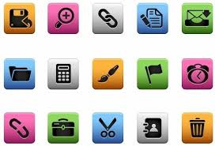
Icons
small picture or image
represents some object in the interface
often a window or action
windows can be closed down (iconised)
small representation for many accessible windows
icons can be many and various
highly stylized
realistic representations.

Slide 14
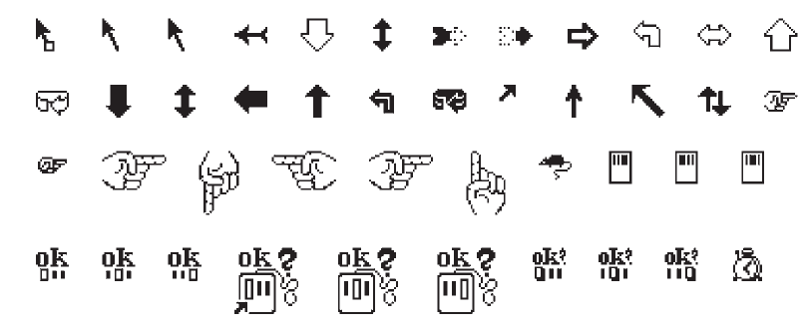
Pointers
important component
WIMP style relies on pointing and selecting things
uses mouse, trackpad, joystick, trackball, cursor keys or keyboard shortcuts
wide variety of graphical images

Slide 15
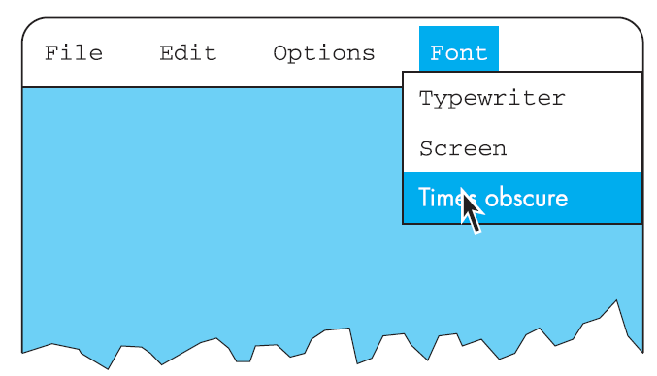
Menus
Choice of operations or services offered on the screen
Required option selected with pointer
problem – take a lot of screen space
solution – pop-up: menu appears when needed

Slide 16
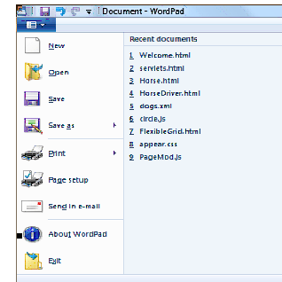
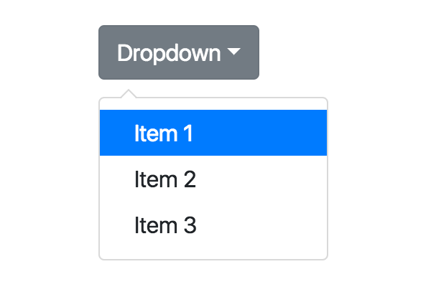
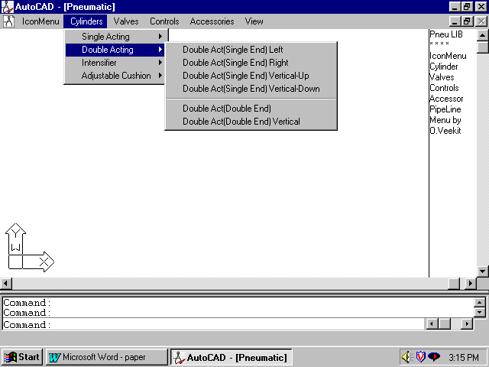
Kinds of Menus
Menu Bar at top of screen (normally), menu drags down
pull-down menu - mouse hold and drag down menu
drop-down menu - mouse click reveals menu
fall-down menus - mouse just moves over bar!

Slide 17
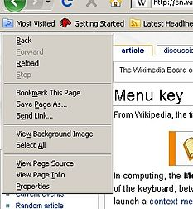
Kinds of Menus
Contextual menu appears where you are
pop-up menus - actions for selected object
pie menus - arranged in a circle
easier to select item (larger target area)
quicker (same distance to any option) … but not widely used!

Slide 18
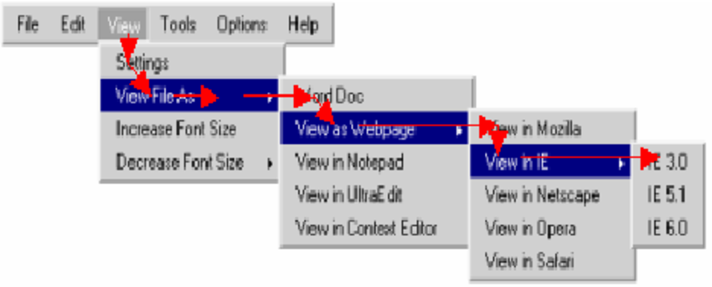
Menus extras
Cascading menus
hierarchical menu structure
menu selection opens new menu
and so in ad infinitum
Keyboard accelerators
key combinations - same effect as menu item
two kinds
active when menu open – usually first letter
active when menu closed – usually Ctrl + letter
usually different !!!

Slide 19
Menus design issues
which kind to use
what to include in menus at all
words to use (action or description)
how to group items
choice of keyboard accelerators

Slide 20
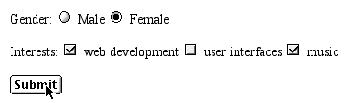
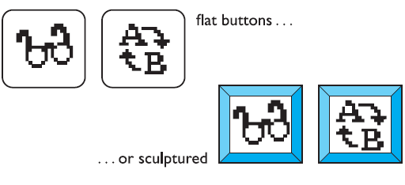
Buttons
Individual and isolated regions within a display that can be selected to invoke an action
Special kinds
radio buttons – set of mutually exclusive choices
check boxes – set of non-exclusive choices

Slide 21
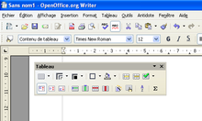
Toolbars
long lines of icons … … but what do they do?
fast access to common actions
often customizable:
choose which toolbars to see
choose what options are on it

Slide 22
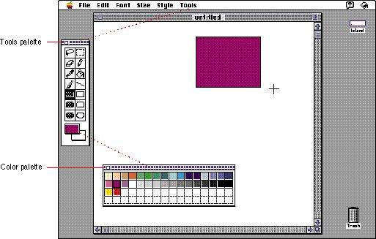
Palettes and tear-off menus
Problem menu not there when you want it
Solution palettes – little windows of actions
shown/hidden via menu option e.g. available shapes in drawing package
tear-off and pin-up menus
menu ‘tears off’ to become palette

Slide 23
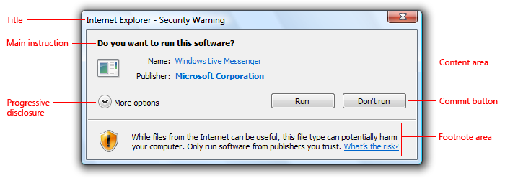
Dialogue boxes
information windows that pop up to inform of an important event or request information.
e.g: when saving a file, a dialogue box is displayed to allow the user to specify the filename and location. Once the file is saved, the box disappears.

Slide 24
Ergonomics

Slide 25
Ergonomics (or human factors)
Study of the physical characteristics of interaction
How the controls are designed
The layout and physical qualities of the screen
About the physical environment in which the interaction takes place
A primary focus is on user performance and the interface enhances or detracts from this
Also known as human factors – but this can also be used to mean much of HCI!
Ergonomics good at defining standards and guidelines for constraining the way we design certain aspects of systems

Slide 26
Ergonomics - examples
arrangement of controls and displays
e.g. controls grouped according to functional, sequential and frequency of use
surrounding environment
e.g. seating arrangements adaptable to cope with all sizes of user
health issues
e.g. physical position, environmental conditions (temperature, humidity), lighting, noise,
use of colour
e.g. use of red for warning, green for okay, awareness of colour-blindness etc.

Slide 27

Industrial interfaces
Office interface vs. industrial interface?
Context matters!
office industrial
type of data textual numeric
rate of change slow fast
environment clean dirty
… the oil soaked mouse!

Slide 28
Glass interfaces ?
industrial interface:
traditional … dials and knobs
now … screens and keypads
glass interface
cheaper, more flexible, multiple representations, precise values
not physically located, loss of context, complex interfaces
may need both
Vessel B Temp
0
100
200
113
multiple representations of same information

Slide 29
Indirect manipulation
office– direct manipulation
user interacts with artificial world
system
industrial – indirect manipulation
user interacts with real world through interface
issues ..
feedback
delays
interface
plant
immediate
feedback
instruments

Slide 30
INTERACTION PARADIGMS

Slide 31
Why study paradigms
Concerns
how can an interactive system be developed to ensure its usability?
how can the usability of an interactive system be demonstrated or measured?
History of interactive system design provides paradigms for usable designs

Slide 32
What are Paradigms
Predominant theoretical frameworks or scientific world views
e.g., Aristotelian, Newtonian, Einsteinian (relativistic) paradigms in physics
Understanding HCI history is largely about understanding a series of paradigm shifts
Not all listed here are necessarily “paradigm” shifts, but are at least candidates
History will judge which are true shifts

Slide 33
The initial paradigm
Batch processing
Impersonal computing

Slide 34
Example Paradigm Shifts
Batch processing
Time-sharing
Interactive computing

Slide 35
Example Paradigm Shifts
Batch processing
Timesharing
Networking
@#$% !
???
Community computing

Slide 36
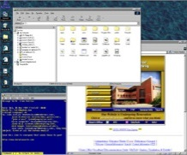
Example Paradigm Shifts
Batch processing
Timesharing
Networking
Graphical displays
Move this file here,
and copy this to there.
C…P… filename
dot star… or was
it R…M?
% foo.bar
ABORT
dumby!!!
Direct manipulation

Slide 37
Example Paradigm Shifts
Batch processing
Timesharing
Networking
Graphical display
Microprocessor
Personal computing

Slide 38
Example Paradigm Shifts
Batch processing
Timesharing
Networking
Graphical display
Microprocessor
WWW
Global information

Slide 39
Example Paradigm Shifts
Batch processing
Timesharing
Networking
Graphical display
Microprocessor
WWW
Ubiquitous Computing
A symbiosis of physical and electronic worlds in service of everyday activities.

Slide 40
Time-sharing
1940s and 1950s – explosive technological growth
1960s – need to channel the power
J.C.R. Licklider at ARPA
single computer supporting multiple users

Slide 41
Video Display Units
more suitable medium than paper
1962 – Sutherland's Sketchpad
computers for visualizing and manipulating data
one person's contribution could drastically change the history of computing

Slide 42
Programming toolkits
Engelbart at Stanford Research Institute
1963 – augmenting man's intellect
1968 NLS/Augment system demonstration
the right programming toolkit provides building blocks to producing complex interactive systems

Slide 43
Personal computing
1970s – Papert's LOGO language for simple graphics programming by children
A system is more powerful as it becomes easier to user
Future of computing in small, powerful machines dedicated to the individual
Kay at Xerox PARC – the Dynabook as the ultimate personal computer

Slide 44
Window systems and the WIMP interface
humans can pursue more than one task at a time
windows used for dialogue partitioning, to “change the topic”
1981 – Xerox Star first commercial windowing system
windows, icons, menus and pointers now familiar interaction mechanisms

Slide 45
Metaphor
relating computing to other real-world activity is effective teaching technique
LOGO's turtle dragging its tail
file management on an office desktop
word processing as typing
financial analysis on spreadsheets
virtual reality – user inside the metaphor
Problems
some tasks do not fit into a given metaphor
cultural bias

Slide 46
Direct manipulation
1982 – Shneiderman describes appeal of graphically-based interaction
visibility of objects
incremental action and rapid feedback
reversibility encourages exploration
syntactic correctness of all actions
replace language with action
1984 – Apple Macintosh
the model-world metaphor
What You See Is What You Get (WYSIWYG)

Slide 47
Language versus Action
actions do not always speak louder than words!
DM – interface replaces underlying system
language paradigm
interface as mediator
interface acts as intelligent agent
programming by example is both action and language

Slide 48
Hypertext
1945 – Vannevar Bush and the memex
key to success in managing explosion of information
mid 1960s – Nelson describes hypertext as non-linear browsing structure
hypermedia and multimedia
Nelson's Xanadu project still a dream today

Slide 49
Multimodality
a mode is a human communication channel
emphasis on simultaneous use of multiple channels for input and output

Slide 50
Computer Supported Cooperative Work (CSCW)
CSCW removes bias of single user / single computer system
Can no longer neglect the social aspects
Electronic mail is most prominent success

Slide 51
The World Wide Web
Hypertext, as originally realized, was a closed system
Simple, universal protocols (e.g. HTTP) and mark-up languages (e.g. HTML) made publishing and accessing easy
Critical mass of users lead to a complete transformation of our information economy.

